Slide 1


Slide 2
RED LETTER DAY
Our goal
Encourage
Inspire
Challenge

Slide 3

CHARGE #1
YOUR LIFE

Slide 4
CHARGE #2: REFLECT ON YOUR LIFE
How?
Define Reality
Examine
3 Questions

Slide 5
CHARGE #2: REFLECT
3 Reflection Questions
When you get where you're going, where will you be?
“When you accomplish the goals of your life, what will you have?”

Slide 6


Slide 7
CHARGE #2: REFLECT
3 Reflection Questions Continued
When you get where you're going, where will you be?
“When you accomplish the goals of your life, what will you have?”
What is the secret to life?

Slide 8
THE TOP 5% MINDSET
MD5 Orientation
85% can be delegated
10% can be trained
5% only you can do: Faith, Family, Friends, Finances, Fitness

Slide 9
THE TOP 5% MINDSET
The 5 F’s
Faith
Family
Friends
Finances
Fitness

Slide 10
INTENTIONALITY

Slide 11
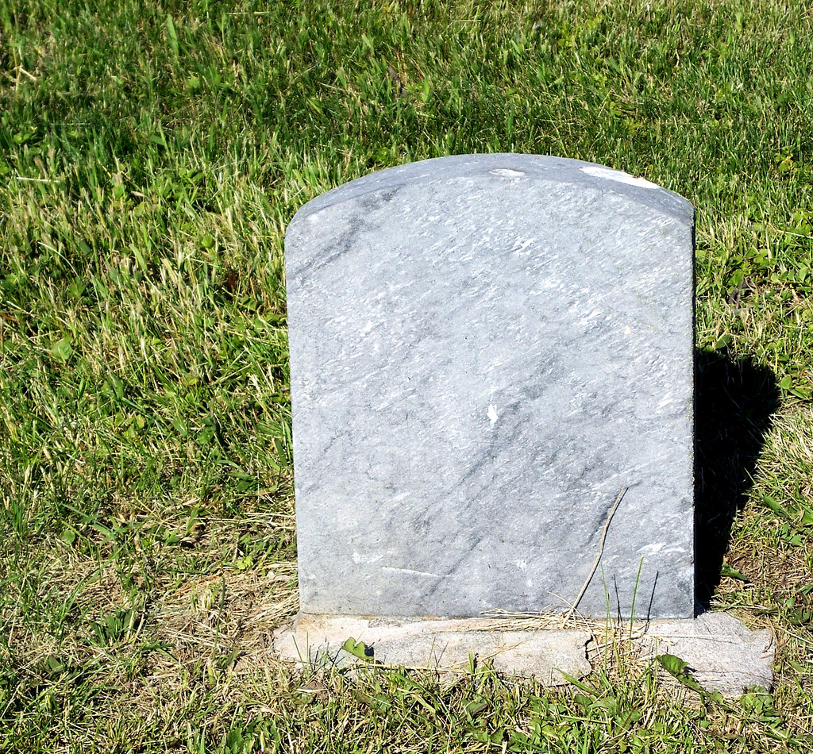
-----------

Slide 12
-----------

Slide 13


Slide 14
CHARGE #3: REFLECT ON YOUR FAITH
C.S. Lewis
“Christianity, if false, is of no importance, and if true, of infinite importance, the only thing it cannot be is moderately important.”

Slide 15
CHARGE #3: REFLECT ON YOUR FAITH
John 3:16
“For God so loved the world that he gave his one and only Son, that whoever believes in him shall not perish but have eternal life.”

Slide 16
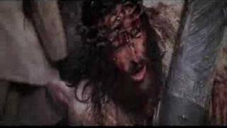

Slide 17
CHARGE #4: REFLECT ON YOUR WIFE
Proverbs 31:10
“An excellent wife who can find? She is far more precious than jewels.”

Slide 18


Slide 19
CHARGE #5: REFLECT ON YOUR CHILDREN
Ephesians 6:4
“Fathers, do not provoke your children to anger, but bring them up in the discipline and instruction of the Lord.”

Slide 20
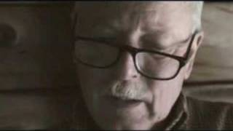

Slide 21
RED LETTER DAY
Become the man God designed you to be!
Simplify → Focus the Top 5%
Faith → No greater relationship in your life than Jesus
Family → Cherish & Disciple your Wife & Kids
Friends → Make Disciples
Fitness → Body Stewardship (Mental & Physical)
Finances → Kingdom Minded & Generous

Slide 22
Red Letter Day

